Slide 1

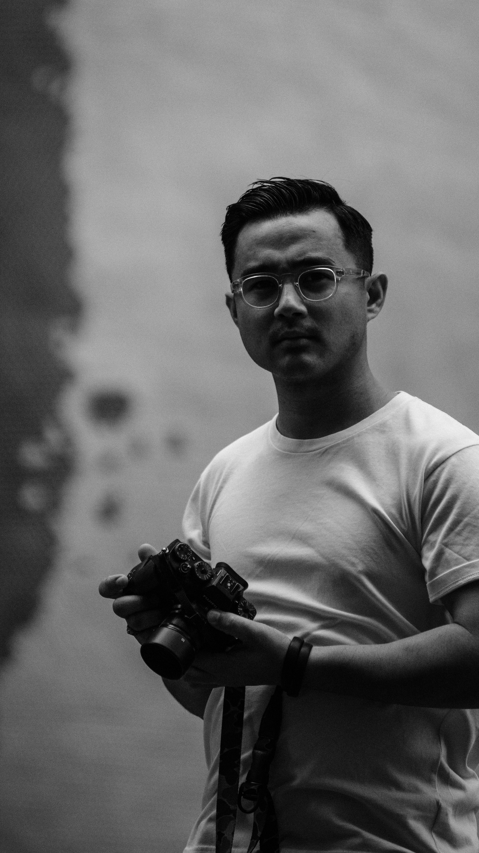
GET ANYTHING AT KU
By : Team Sui Generis
Supervised by : Dhiraj Shrestha

Slide 2
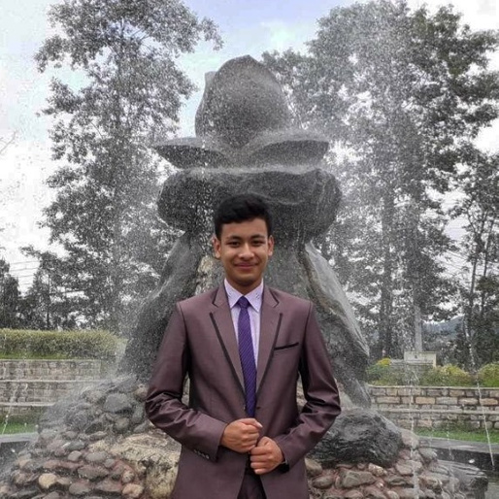
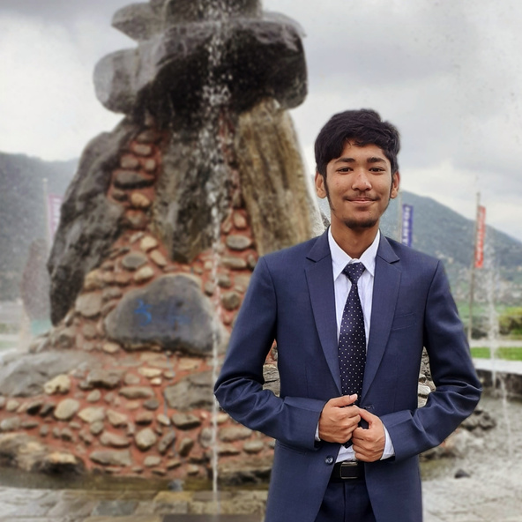
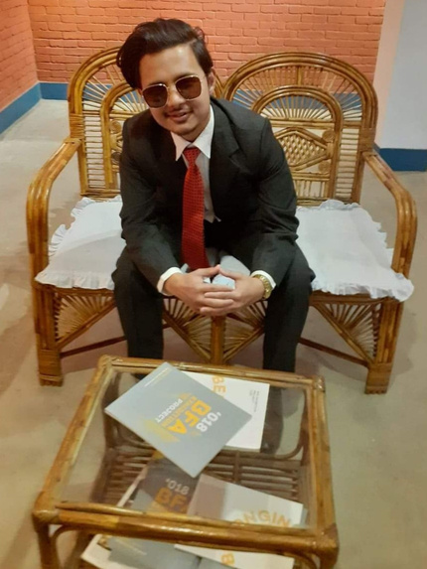
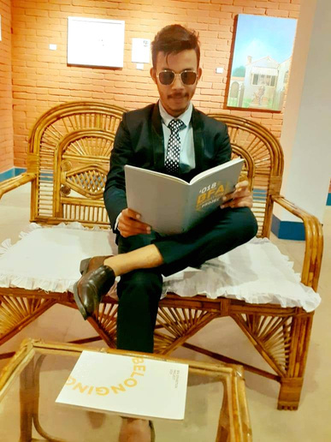
MEET TEAM SUI GENERIS
Kushal Manandhar
Ishar Maharjan
Aron Shrestha
Hritik Thapa

Slide 3
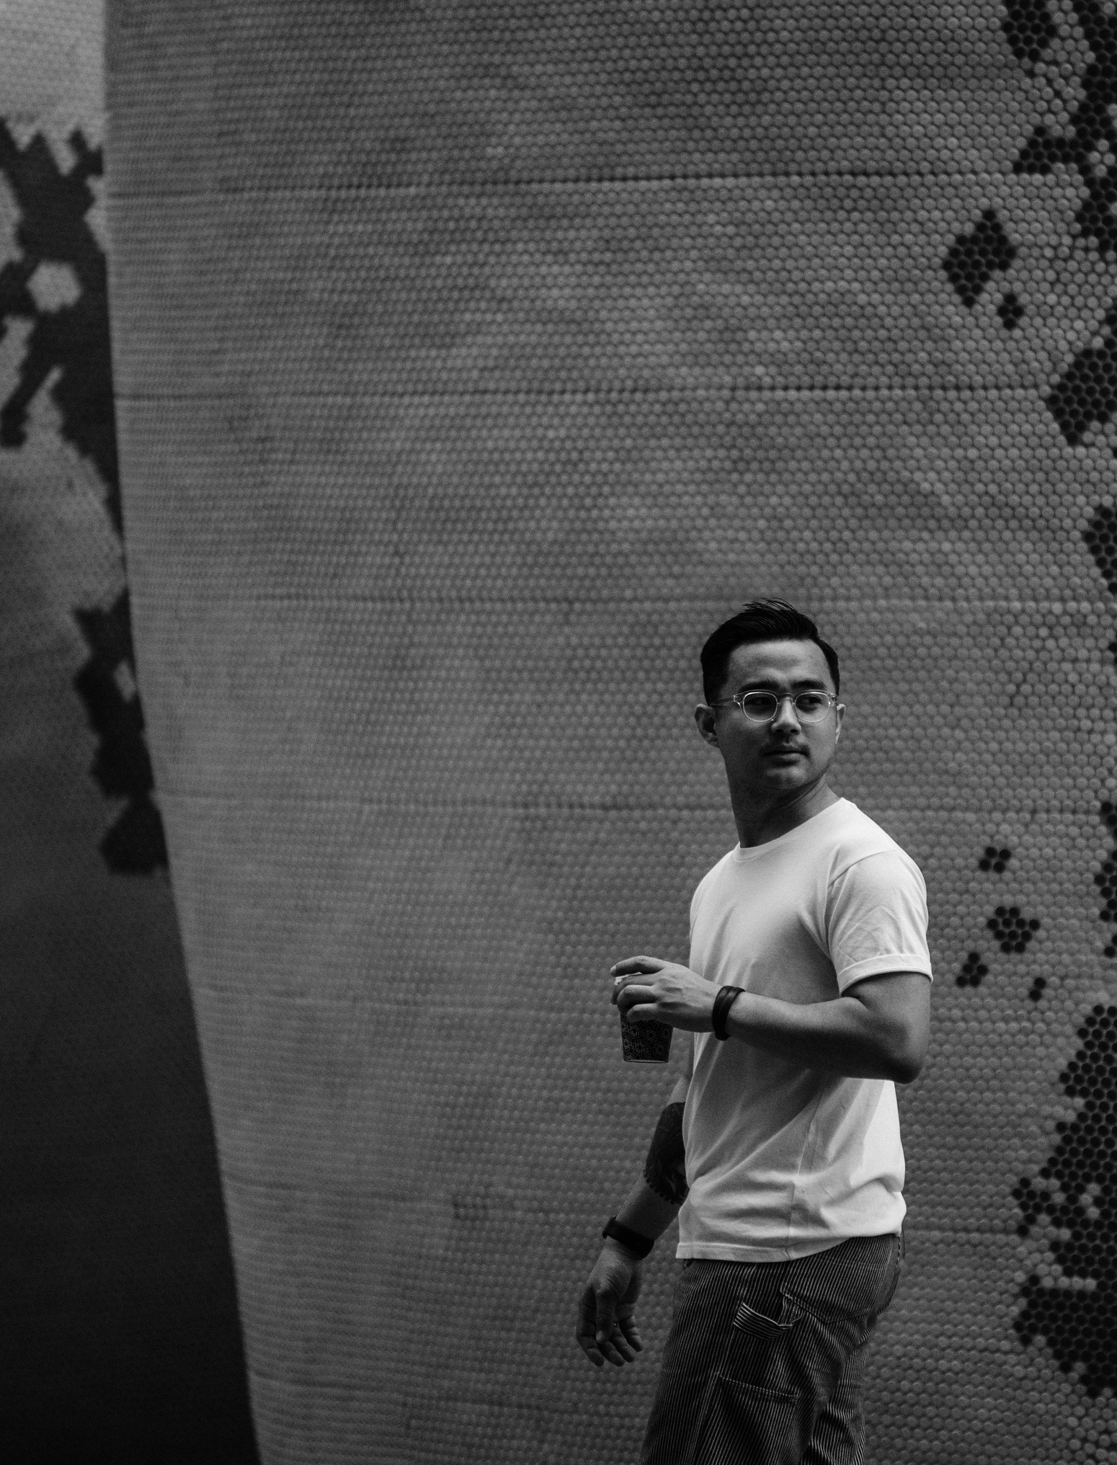
INTRODUCTION
Small-Scaled
Chicken nuggets
Mini quiche pies
Bagels
Chocolate chip cookies

